Slide 1
Sleep & Dreaming

Slide 2
The Freudian Theory of Dreaming
Research Study
Freud (1918): dream analysis study of ‘TheWolfman’.
MASTER CLASS

Slide 3
Background
Wolfman was a pseudonym for one of his patients, who we now know is Sergei Pankejeff.
Freud believed in the power of therapy and was interested in the origins of mental illness.
Freud’s type of therapy was called psychoanalysis. This led him to develop his theory of dreams & dream analysis.

Slide 4
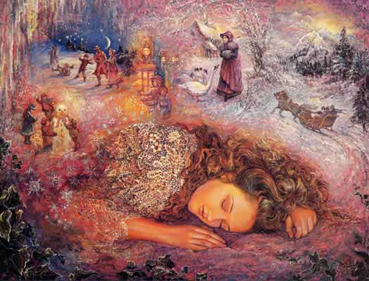
Aim
Freud wanted to try to explain and treat Wolfman’s psychological problems through dream analysis.

Slide 5
Case Study
Read page 189 and complete the table below
What are the key features of a case study?
What different types of case studies are there?
Describe some examples of case studies in psychology.
Why is the Wolfman an example of a case study?
Strengths of case studies
Weaknesses of case studies

Slide 6
Method
DESIGN
Case study to investigate the Wolfman’s mental illness.
Freud carried out a a series of interviews from 1910-1914 – so it was a longitudinal study.
SAMPLE
Sergei Pankejeff, man in his 20s from a wealthy Russian family.
Older sister committed suicide in 1906 & his father in 1907 (suffered depression).
Pankejeff suffered depression, and other physical psychological problems.
PROCEDURE
Freud analysed one particular dream that Pankejeff had as a young child (see over page for the dream).

Slide 8
Results: Freud’s analysis of the dream
Manifest Content
The wolves watching Sergei as a boy
The tree in the dream
White wolves
Wolves in the tree
Feared the wolves would eat him
Wolves having big tails
Latent Content
The dream was a result of Pankejeff witnessing at a very young age a ‘primal scene’ of his parents having sex. The wolf symbolised his father.
A Christmas tree as the dream occurred at Christmas time, where there would have been Christmas present there were wolves.
Represented the white bed linen and underclothes of his parents.
Pankejeff had an unconscious desire to be seduced by his father (like the pleasure of receiving Christmas gifts). Gifts = wolves = his father. Freud believed he wanted to experience the pleasure he had seen in his mother’s face but believed his mother must have been castrated (no penis) by his father during the sex act.
He feared his father’s power and developed castration anxiety (fear of losing his penis).
Symbolised larges penises which were a threat to the boy.
Overall: Pankejeff repressed his unconscious fear of his father but displaced it onto wolves.

Slide 9
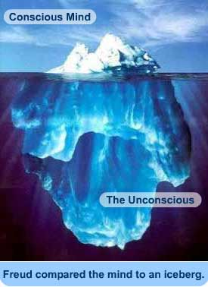
Conclusion
The unconscious mind can have a significant effect on behaviour.
Shows the process of repression, where traumatic events are pushed into the unconscious mind as a safety mechanism- but that repressed memories can find their way back into the conscious through dreams.

Slide 10
Is this research scientific?
Who can identify the most weaknesses in 2 minutes?

Slide 11
Criticisms
Sample size is only one person - only Sergei
Too small to make generalisations and is not reliable to base a theory of dreams on.
+ It might be that other people do not use dreams as a way of symbolizing traumatic experiences.
Study – strong focus on the unconscious – but this is an abstract concept that cannot be observed or reported on by the person.
+ Dreams are quite abstract and do not provide hard evidence; and there is also no way of knowing if Wolfman’s
recall is accurate.
The study is too subjective.
The results are one person’s (Freud) view of a dream and are therefore biased.
+ Another psychologist could have had a very different interpretation.

Slide 12
Mapping Freud’s Study of the Wolfman
Create a storyboard that outlines the study using visual cues to help recall.
Background
Aim
Method - design
Method - sample
Method - procedure
Results
Conclusion
Criticisms

Slide 13
CHALLENGE TASK – evaluating theories & studies
Use your knowledge and understanding from across the psychology course to explain how far you agree with the following statement:
‘Freud’s approach to explaining dreaming is too subjective’.
Freud’s Theory of Dreaming
STEP 1: Outline the theory
Freud’s Theory of Dreaming suggests that…
STEP 2: Explain TWO ways in which it can be seen as subjective. Include examples. HINT: look at the criticisms.
Freud’s Theory can be seen as too subjective because….
STEP 3: Make an overall statement about whether Freud’s theory is too subjective to explain dreaming.
I believe that Freud’s theory is too subjective to explain dreaming because…
However, it still broadens our understanding because…
Freud’s Study of the Wolfman
STEP 1: Outline the study
In his case study of the Wolfman Freud….
STEP 2: Explain TWO ways in which it can be seen as subjective. Include examples. HINT: look at the criticisms.
Freud’s study can be seen as too subjective because….
STEP 3: Make an overall statement about whether Freud’s study is too subjective to explain dreaming.
I believe that Freud’s study is too subjective to explain dreaming because…
However, it still broadens our understanding because…

