Slide 1
What would you do?
If you found this on the pavement on your way home from school?

Slide 2
https://www.youtube.com/watch?v=giLhBFBah5k
https://www.youtube.com/watch?v=zZ3l1jgmYrY

Slide 3
Research Methods: Ethical Considerations
Learning Objective:
To explain different ethical considerations and discuss how they are dealt with
What does the word ‘ethics’ mean?

Slide 4
Ethics
Desirable standards of behaviour we use towards others
If we behave ethically, we treat others with respect and have concern for their well-being
Psychologists have legal and moral responsibilities to those who help them in their research
Ethical concerns also apply to animals as well – but the main concern is for humans….why?

Slide 5
Ethics
Participants put their trust into the researchers
If researchers betray trust then this discredits the profession and makes it less likely that others will agree to take part in the future
British Psychological Society (BPS) have published guidelines for us to follow to ensure we are addressing all ethical concerns
These guidelines apply to anyone conducting any scale of psychological study – even you!

Slide 6
BPS Code of Human Research Ethics 2014
Respect for the autonomy, privacy and dignity of individuals and communities
Moral duty of care to respect participants cultural and individual differences; age, gender, sex, religion and culture
Scientific integrity
Not claim misleading findings
Social responsibility
Findings must be beneficial
Maximising benefit and minimising harm
Should not be placed in a situation that they would not usually be in or put under risk

Slide 7
Informed Consent
Researcher must outline to the participant what the research entails and ask their consent to take part
Adults must give consent to participants under the age of 18
Not always possible to gain informed consent
Sometimes there are things you can’t tell the participant as you may spoil the research and demand characteristics could play a role

Slide 8
Deception
Sometimes deception is necessary to avoid demand characteristics
Participants must be deceived as little as possible
If they are children – parents should be told the details of the study to ensure for less deception
The true nature of the research should be highlighted as soon as possible

Slide 9
Confidentiality
Any data gained from participants must be kept anonymous unless they give their full consent

Slide 10
Debriefing
Must be debriefed at the end of the study
Every purpose and detail must be explained
They must also then be reminded that they can still withdraw if they feel necessary

Slide 11
Right to withdraw
When participants agree to take part they may not know the full extent of the investigation
Participants must be told that they are free to withdraw from the study at any time during the study
They should also be reminded, especially if it’s a long study
They are never under any obligation to continue
If they decide to leave, any information gathered from them must be deleted

Slide 12
Protection of participants
The guideline that participants should always be protected from physical and psychological harm
Psychological harm is quite subjective as some people may be more distressed or embarrassed than others, so it is important to consider how each participant may feel
Researchers should highlight this and reduce these risks

Slide 13
Ethics
Informed Consent
Deception
Confidentiality
Debrief
Right to withdraw
Protection of participants
Can do can’t do with participants!

Slide 14
Exam Style Question

Slide 15
Is this ethical?
https://www.youtube.com/watch?v=Ntoix9JcDig
https://www.youtube.com/watch?v=K-59VkppgsI
https://www.youtube.com/watch?v=tXWztwxtdIg
Put on your ethical hats!
Imagine you work for BPS
Analyse these clips and note down where and when ethical guidelines have been broken!
Notes:
http://www.channel4.com/programmes/the-secret-life-of-4-and-5-year-olds/on-demand/66093-005

Slide 16
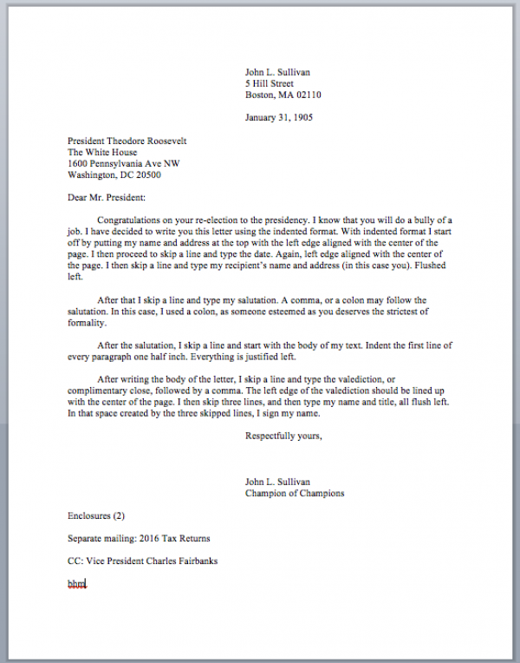
Application
Write a letter to Zimbardo or Milgram to explain to him why his study was unethical
Pretend you are from the BPS and it is your duty to inform him that he has breached many of the ethical guidelines
You must include…
Your address
Their address
Your explanation in paragraphs
Your name/who you are
Notes:
Need lined paper

Slide 17
Some help…
Make up the addresses
Starter: ‘I am writing to you to inform you that you have breached the British Psychological Society ethical guidelines and this is a very serious incident.’
‘One ethical guideline that you have broken is ‘protection from harm’ and this means that you have inflicted some kind of harm on your participants. I believe you did this by…’

