Slide 1
https://getrevising.co.uk/planner
Your FREE revision timetable

Slide 2
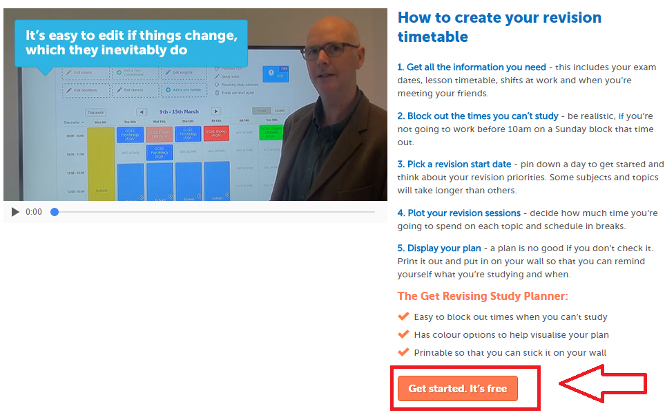
https://getrevising.co.uk/planner

Slide 3
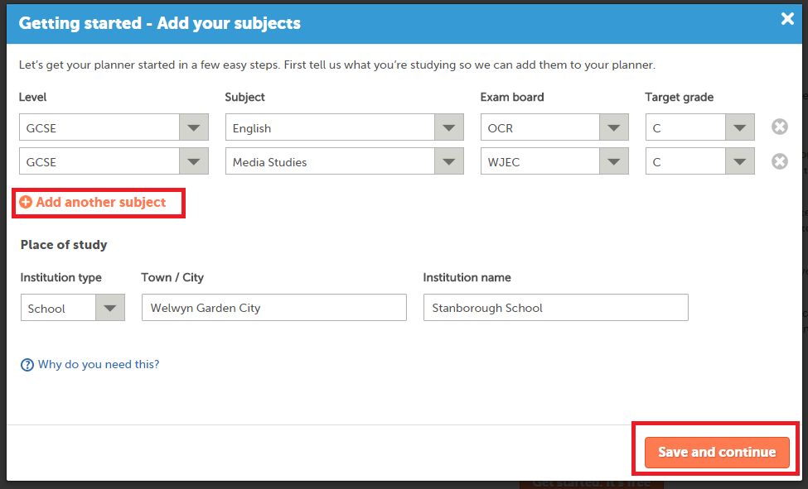
Add all the subjects you have
https://getrevising.co.uk/planner

Slide 4
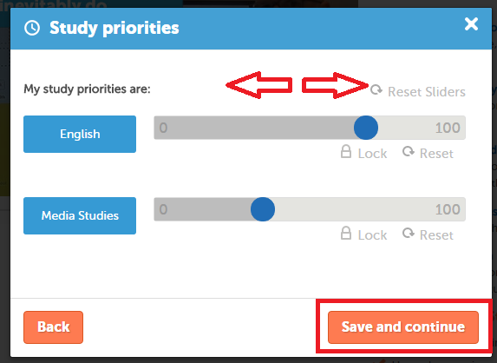
Choose which subjects you would like to spend more time on.
https://getrevising.co.uk/planner

Slide 5
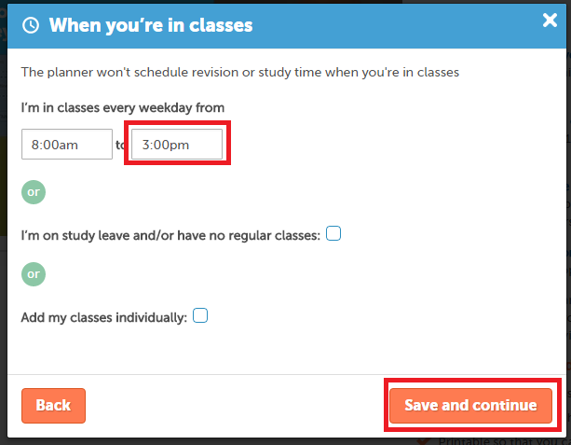
Revision time will not be scheduled during the times you have lessons
https://getrevising.co.uk/planner

Slide 6
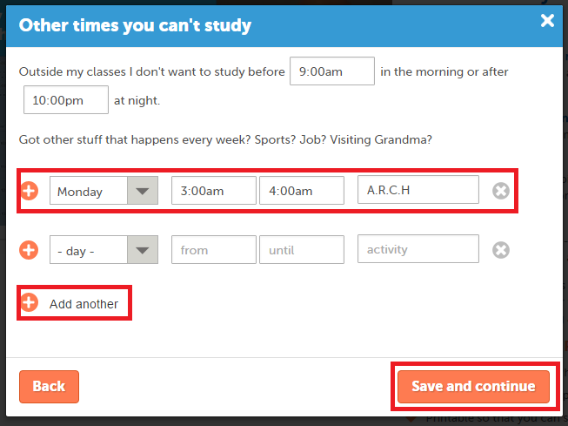
Add in other commitments you have
ie. Extra curricular or extra intervention.
This can be edited later.
https://getrevising.co.uk/planner

Slide 7
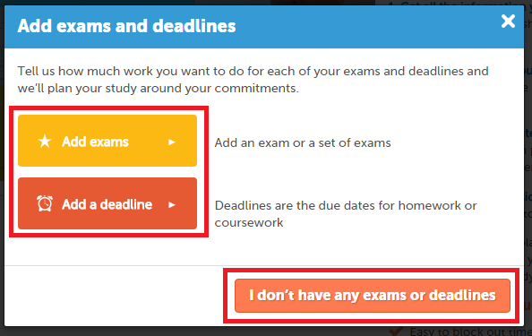
Check with your teachers…
Get Revising will help you schedule revision time for upcoming exams.
Cool!
https://getrevising.co.uk/planner

Slide 8
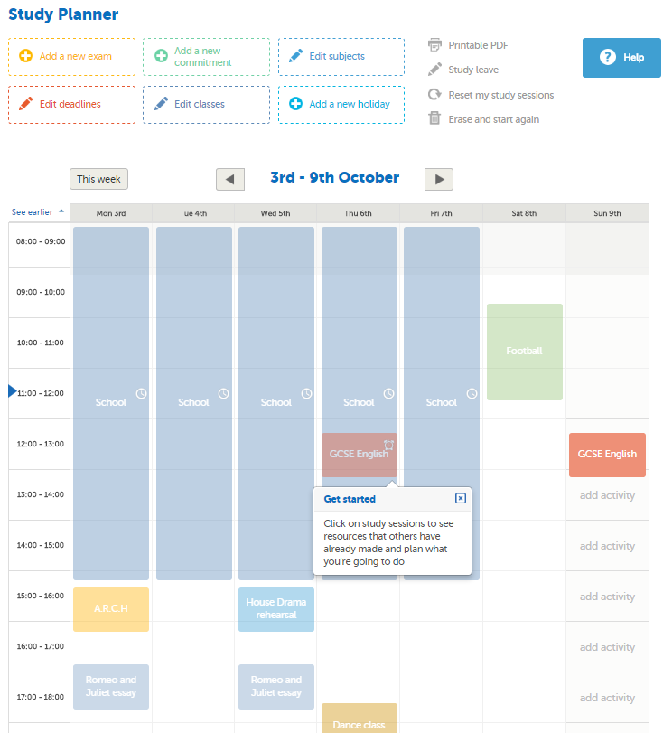
Your planner…
https://getrevising.co.uk/planner

Slide 9
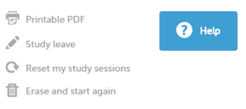
https://getrevising.co.uk/planner

Slide 10
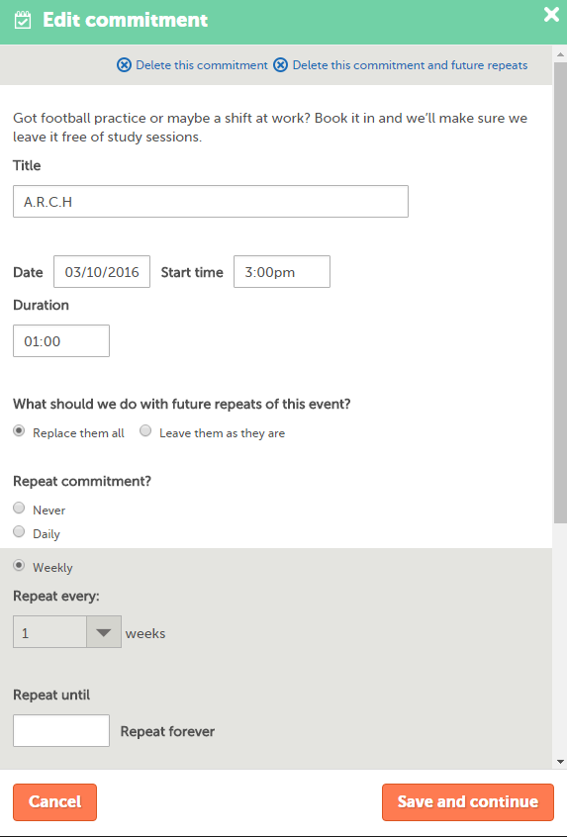
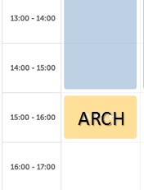
Edit an activity

Slide 11
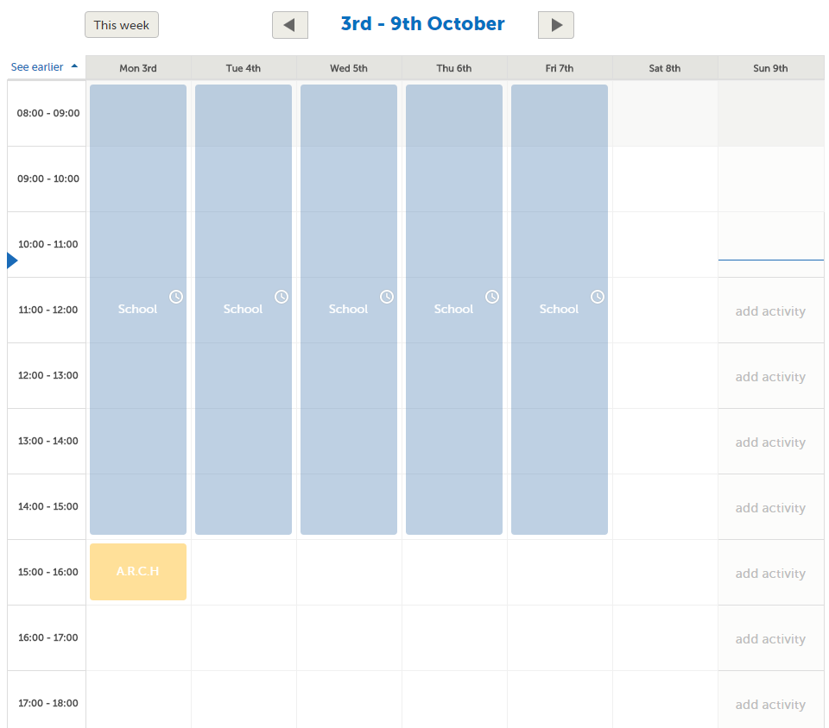
Automatically added in Weekly
ARCH

Slide 12
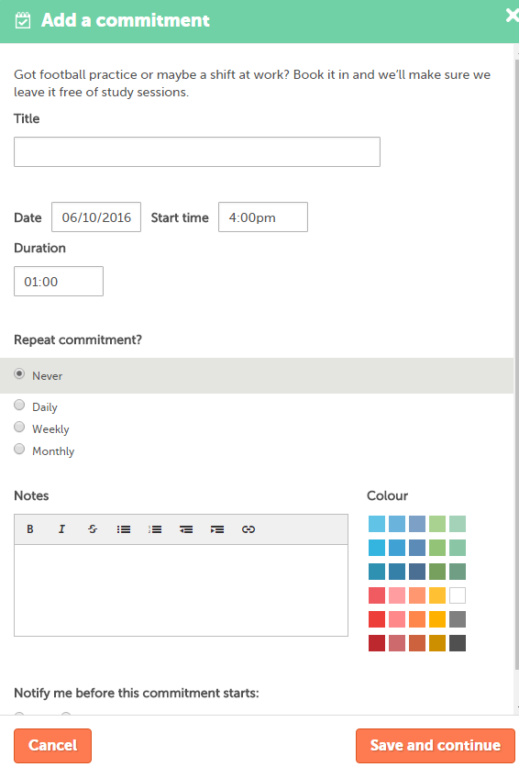
Click anywhere on your timetable to add a new deadline or new commitment.

Slide 13
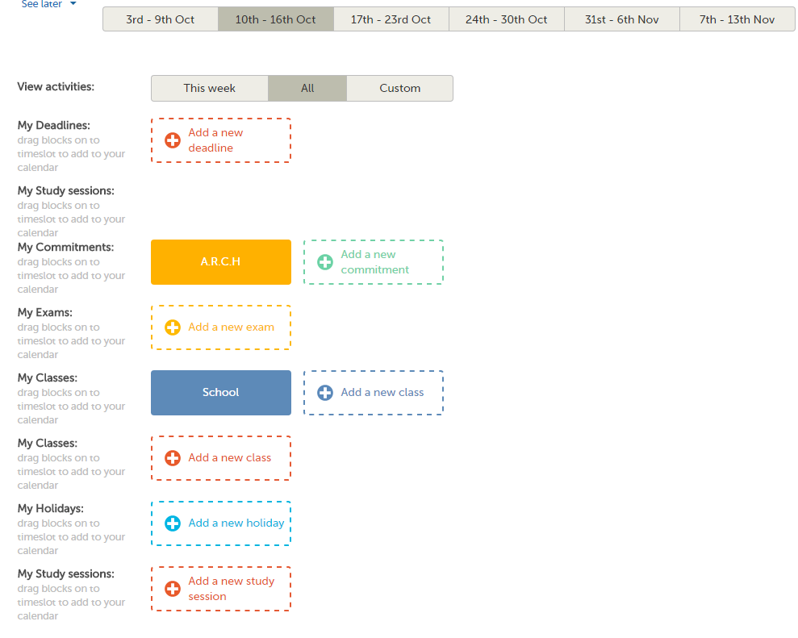
You can add new exams, holidays, deadlines, study sessions, anytime!

Slide 14
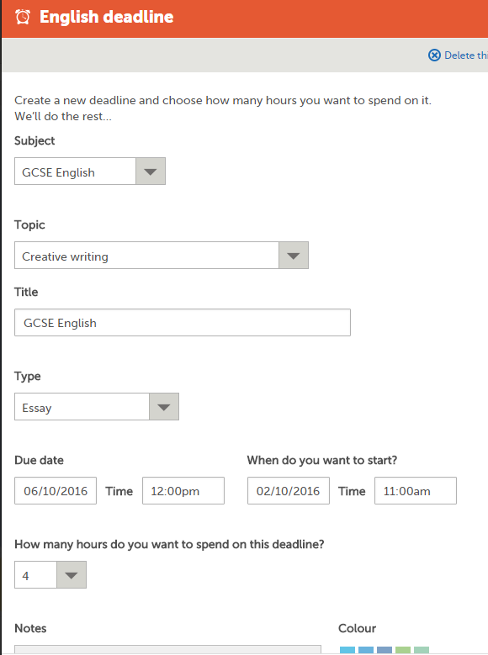
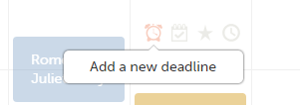
Deadlines
Step 2:
Fill in the form and save
Step 1:
Scroll over a blank section of your planner and click the clock icon

Slide 15
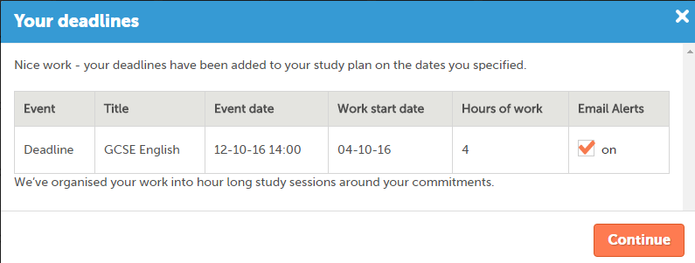
COOL!

Slide 16
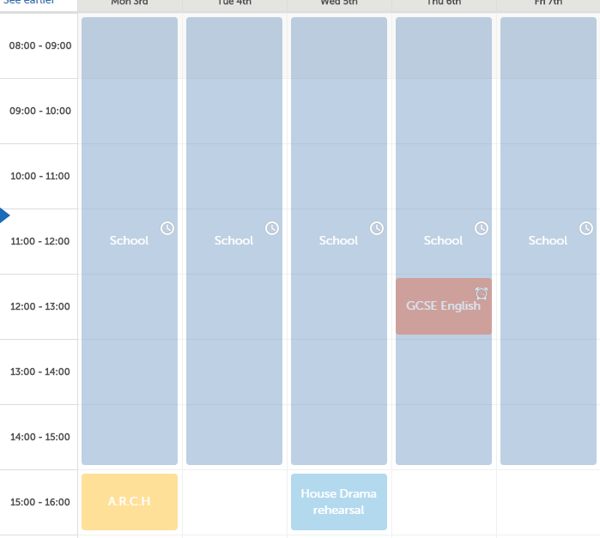
Deadline added!

Slide 17
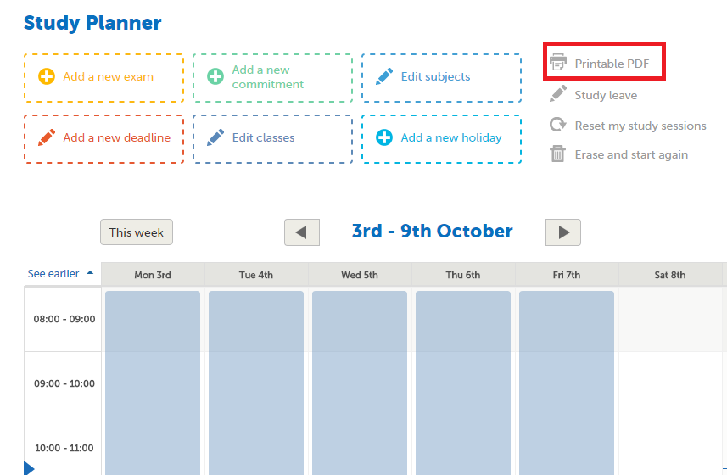
https://getrevising.co.uk/planner

Slide 18
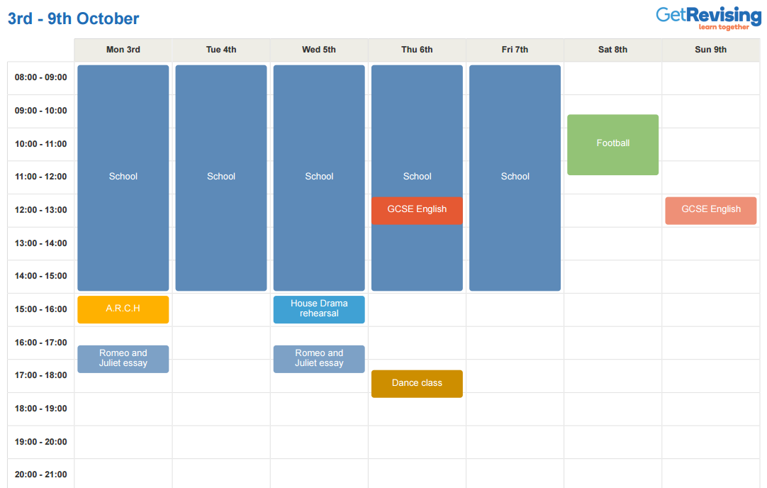
Simply print and post near your study space at home!
https://getrevising.co.uk/planner

