Slide 1
Research Methods: Methods of Investigation - Interviews
Learning Objectives:
To explain interviews as a method of collection of data
To evaluate interviews as a method of data collection
Starter:
Half the class– outside!
The other half--- 5 questions for your partner. You have to get them to say why they took Psychology, without asking that question.

Slide 2
Welcome to your interview.
Please have a seat in front of your interviewer.
Do not be nervous.

Slide 3
Variables
Independent Dependent

Slide 4
Interviews
Structured
Series of fixed questions
Limited range of answers
Fast to complete
Provide rich data easy to analyse
Does it provide rich data?
Semi-structured
Open ended questions
Respondents can speak freely (may be irrelevant?)
More depth
Difficult to compare answers
Unstructured
No prepared questions nor a schedule
Broad aim but no rules

Slide 5
Interviews
Strengths | Weaknesses
Detailed Avoids over simplifying Greater attention to individual’s view point | Demand characteristics/interviewer effects Difficult to analyse Time consuming and so expensive
Expand on each point to turn it into an evaluation point

Slide 6
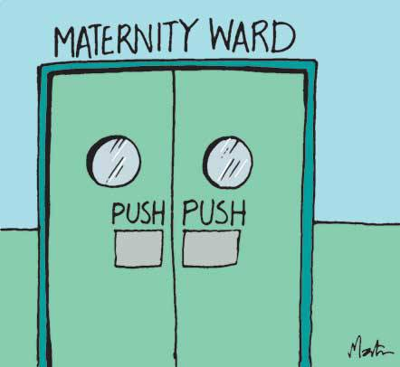
Exam question
A researcher wanted to investigate the impact of a new postnatal care programme on a small, local maternity ward. The researchers were interested in what women felt about the postnatal experience and if they thought it could be improved
Explain what type of interview would be most suitable for this type of investigation (3 marks)

Slide 7
Answer
An unstructured interview may be appropriate as the research is investigating the individual experiences of women during postnatal care. Postnatal care is likely to be very different for most women so it would be appropriate to have flexibility with the questions asked and it allows the research to explore different areas of the conversation freely.

Slide 8
Exam question
A researcher wanted to investigate the impact of a new menu at the local school. Three year 7s were interviewed. The only aim, was to see what their favourite canteen foods were.
Explain what type of interview would be most suitable for this type of investigation (3 marks)
What are some issues with this experiment? Think procedure and sample

